Slide 1


Slide 2


Slide 3
Developing Safety Huddles to Meet Organizational Needs
Brett Shipley MSN, RN
Patient Safety Officer
Ann Steffe MSN, RN, PCCN
Director of Critical Care Services

Slide 4
Learning Objectives
Understand how to impact the Culture of Safety through daily leadership safety huddles by creating accountability, transparency, and improved communication
Understand how to utilize a process improvement team to develop an efficient and effective safety huddle based on the needs of a unique organization

Slide 5
A GAP in Safety
Identified gaps in safety across the organization
  A lack of accountability amongst leadership
  Limited transparency of safety events
  Silos around safety with minimal communication
  Did not have effective or efficient processes to improve safety

Slide 6
Safety Huddles
Safety huddles discuss and assess impact of patient, workforce, and environmental potential/actual safety events from (Thompson, S.E., 2015):
  The past 24 hours
  The next 24 hours
  External factors that could affect safety (supplies, weather, outbreaks, etc.)
May be known as a brief or a huddle based on organizational preference/practice

Slide 7
Safety Huddles…
Discuss patient, workforce, and environmental safety hazards on a daily basis
Improve communication of potential/actual safety events
Create and sustain an environment of high reliability
Increase real time situational awareness among all workforce members, including senior leaders
Coordinate resolution of reported potential/actual safety events (Thompson, S.E., 2015)

Slide 8
Next Steps
Placed on Strategic Plan to “Implement and Hardwire Safety Huddles”
Administration and BOD Support
Established a Process Improvement Team
  90 Day Team
  Intentional selection of an inter-professional team

Slide 9
90 Day Team Process
Develop a team charter (plan)
Problem Statement
Identify and determine roles of key stakeholders
Voice of the Customer
Set outcome goals
Use Plan Do Check Act Evaluate (PDCAE) to guide team process

Slide 10
Developing the Safety Huddle
Understand organizational weaknesses:
  Accountability
  Transparency
  Interdepartmental Communication
Meet Stakeholder requirements:
  Strong preparation
  Efficient and value added

Slide 11
Evaluate EBP and Best Practices
Seek best practices from inside and outside of healthcare
Build a huddle format that will intentionally strengthen organizational weaknesses
  Identify the who, when, and how(infrastructure)
Goal: promote and nurture a blame free environment that increases collaboration between work areas and minimizes the silo effect

Slide 12
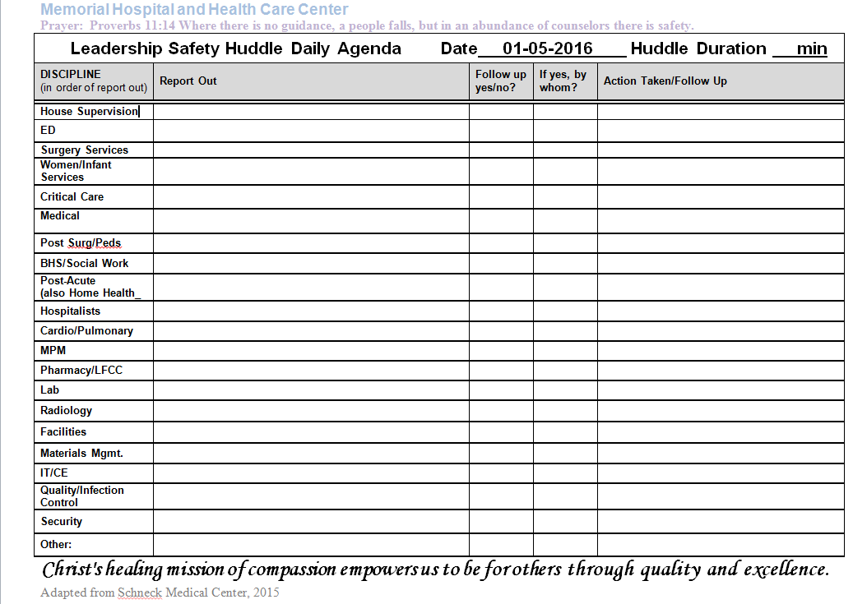
Developing Your Tools and Processes
Efficient and Timely: Intentional Agenda
  High Risk Areas first to report, include phys. Practices

Slide 13
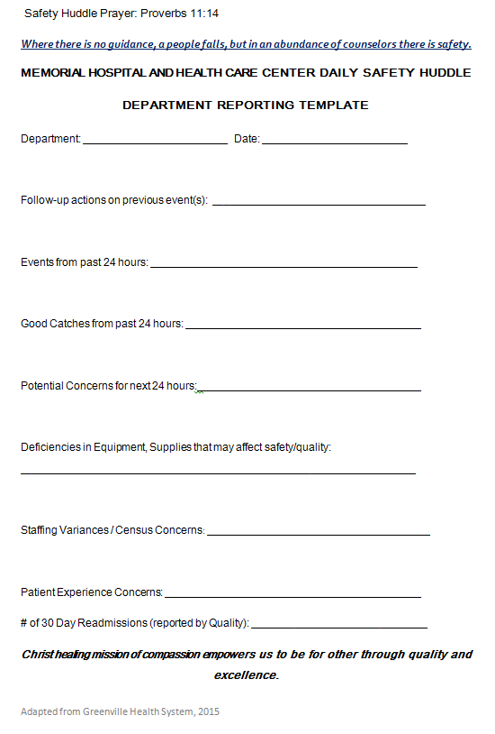
Improved Communication
All directors or designee expected to attend and use concise reporting
Department Reporting Template built as guideline

Slide 14
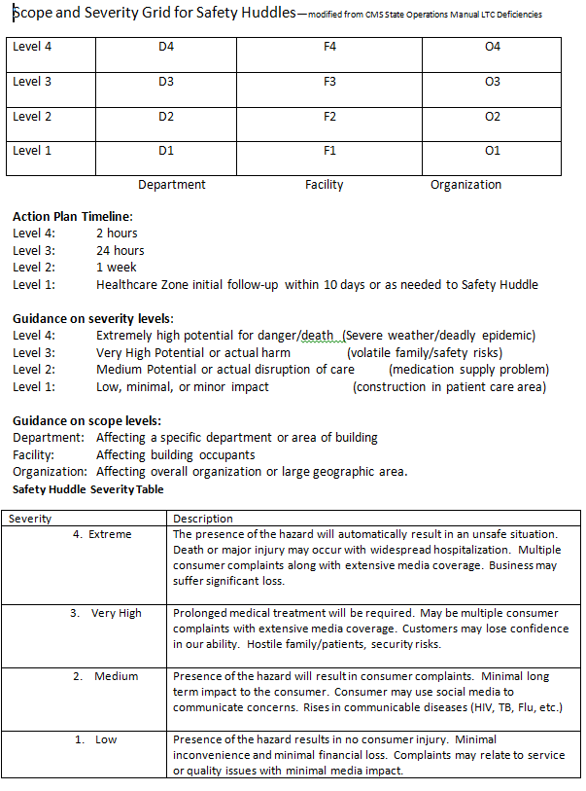
Accountability
Scope and Severity Grid
Built by security and nursing using CMS Long Term Care Deficiency rating grid as a source.

Slide 15
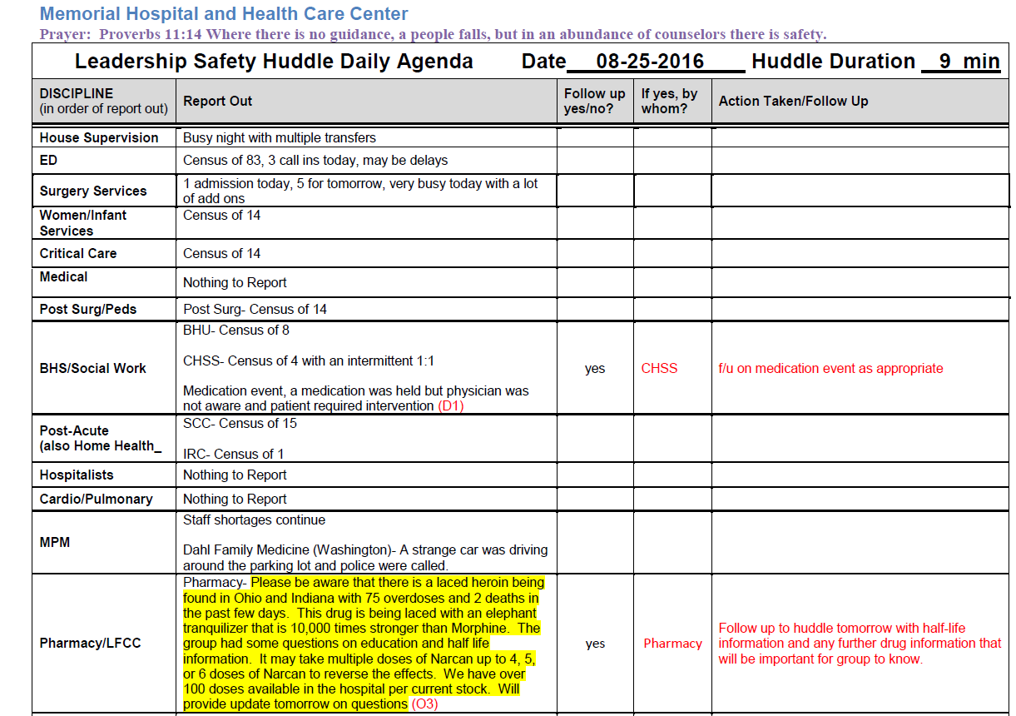
Transparency
Huddle Notes on Intranet within 2 hours

Slide 16
Build a Process
Infrastructure: Pick a dedicated space and book the room for a year
  Phone line access for off site leaders, get IT involved early
How will you:
  Get information from the departments to the huddle (reporting template)
  Have an efficient way to communicate the information (intentional agenda)
  Prioritize and use the information (Score and Severity)
  Get the information back to the WF (Notes)
Who will be responsible for each part of the process?

Slide 17
Preparing Others for Huddles
Mock Huddle with a small control group
  Team + select leaders that are prepared 1:1
  Debrief
Leadership wide education and live huddle example
  1:1 preparation with all departments listed on agenda before example huddle
Workforce education
2 full-scale mock huddles with debrief

Slide 18
Outcomes
House Supervisor daily e-mail at 0700 to leadership
  HS coverage currently 1500-0700 and weekends
  Status of census, staffing, and any major events
Implemented January 4th, As of August 31st:
  171 Huddles
  5.87 minute average
  1033 Reports assigned Scope and Severity Ratings

Slide 19
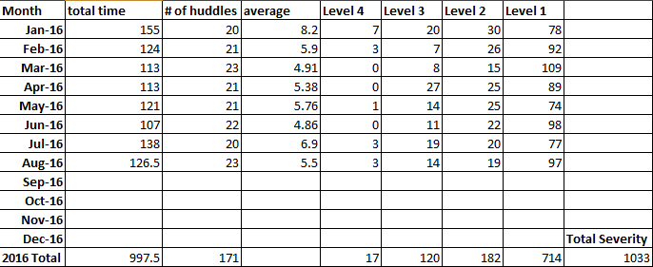
Severity Data

Slide 20
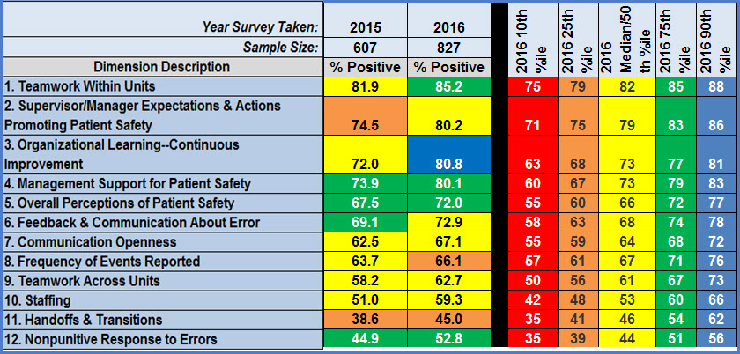
2015 to 2016 Survey Results

Slide 21
Culture of Patient Safety Results
Organizational Learning- Continuous Improvement: 72.0 (2015) ↑ 80.8% positive (2016)
  We are actively doing things to improve patient safety: 84 ↑ 91% Positive
Feedback and Communication About Error: 67.5%( 2015) ↑ 72.9% positive (2016)

Slide 22
Leadership Specific Survey Results
The actions of hospital management show that safety is a top priority
  76% up to 84%
Non Punitive Response to Errors:
  44.9% ↑ 52.8%
My supervisor/manager overlooks patient safety problems that happen over and over
  75% ↑ 83%

Slide 23
Next Steps
Continue to coach and develop leaders on appropriate reporting information and techniques
Expansion to Weekends with House Supervisor and shift leads
Continue to explore best practices and make changes as needed
Expand tracking of data to ensure follow-ups are being met
Continue to support and nurture the Culture of Patient Safety

Slide 24
Questions?

Slide 25
References
Centers for Medicare and Medicaid Services. (2014). State Operations Manual. Washington, D.C.: Centers for Medicare and Medicaid Services
Schneck Medical Center. (2015). Roll call/follow up for safety huddle. Seymour, IN: Schneck Medical Center
Thompson, S.E. (2015) Conducting effective safety huddles. Clinton, SC: Greenville Health System.

